Slide 1
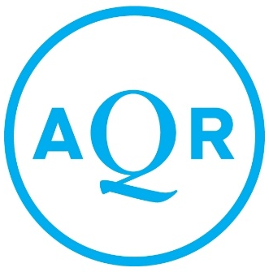
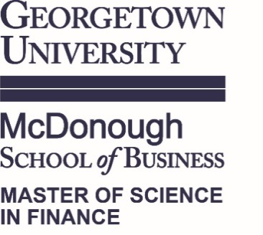
Trailblazing Momentum Strategies in Mutual Funds
Assessing AQR’s Position and Exposure in 2009 and 2019
Prepared for:
Cliff Asness, Manager & Founding Principal
David G. Kabiller, Founding Principal
John Liew, Founding Principal

Slide 2
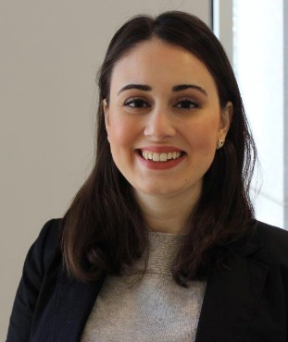
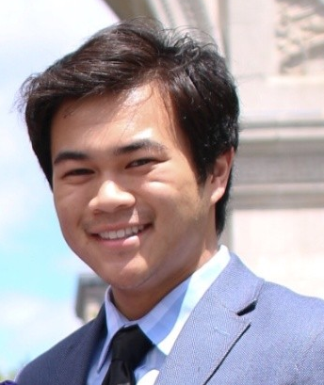
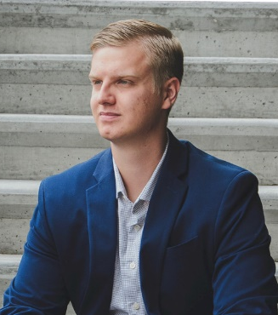

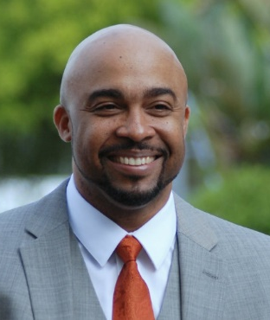
GEORGETOWN MSF CONSULTING TEAM
Dilara
Akgunduz
da758@Georgetown.edu
MSF VII
KPMG – Advisory
Chicago, IL
M&A Consultant – HR Function
Aspiring dog owner
Matthew
Hayashi
mth77@Georgetown.edu
MSF VII
Exiger Diligence
Washington, D.C.
Intern, Student
Aspiring trophy husband
Zane
Lovell
zl291@Georgetown.edu
MSF VII
Digital World AV
Fayetteville, AR
Analyst/Project Coordinator
Aspiring blueberry farmer
Devante Robinson
djr103@Georgetown.edu
MSF VII
Tampa PD
Tampa, FL
Law Enforcement Officer
Aspiring fuh-nance assassin
Michael Robinson
mr1230@Georgetown.edu
MSF VII
Georgetown U.
Washington, D.C.
Director of AP
Aspiring official Georgetown Uber driver

Slide 3
Demonstrating the Business Need for a Momentum-Based Mutual Fund
AQR wanted to use momentum strategy to pioneer the retail mutual fund market.
This would in effect increase AQR’s revenue.
Backtesting shows favorable results for investors and AQR.
We support the 2009 strategy. BUT!
There is a but…

Slide 4
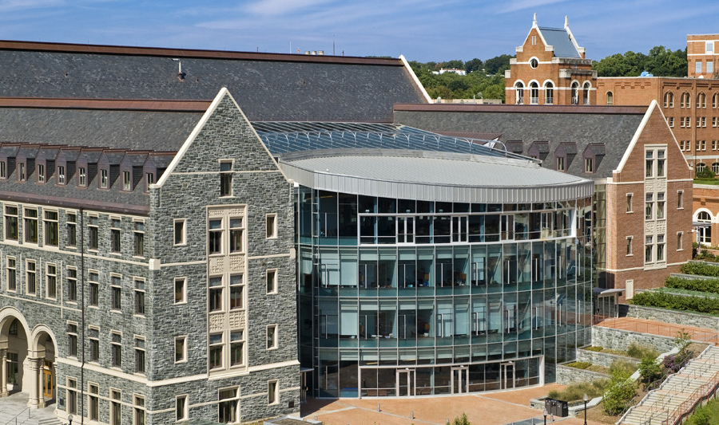
2009: The Year OF “I Gotta Feeling”

Slide 5
Do the Strengths Outweigh the Pitfalls?
High Liquidity Required
Untapped Capital
Marketing Hurdles
Brand of CEO
Weaknesses
Academic Regard
VS.
Strengths

Slide 6
Understanding the 2009 Environment: Retailers are Hungry for New Investment Strategies
Fed announces QE round in Q1 2009
Investors encouraged to spend
Investors make riskier investments
A positive alpha is desirable for investors.
Momentum creates positive alphas.

Slide 7
Evidence Supports Momentum Strategies in Mutual Funds
1926-2009 | Market | Large Cap Momentum
Avg monthly return (μ) | 0.88% | 1.19%
Std. Deviation (σ) | 5.49% | 5.64%
Sharpe Ratio | .1042 | .1314
β (CAPM) | 1.0000 | 0.9617*
α (CAPM) | - | 0.0034
α (Fama3) | - | 0.0038
α (Fama3 + Mom) | - | -0.0005*
Results from Fama-French Data Library, * indicates significance

Slide 8
coulda, woulda, shoulda

Slide 9
It is Not Always about the Sharpe Ratio
2009-2019 | Market | AMOMX
Avg monthly return (μ) | 1.13% | 1.12%
Std. Deviation (σ) | 3.79% | 4.01%
Sharpe Ratio | .30 | .27
β (CAPM) | 1.000 | -0.1925
α (CAPM) | 0.000 | 0.01300
α (Fama 3) | 0.000 | 0.01349
Results from Fama-French Data Library

Slide 10
Looking at AMOMX vs. Large Cap Momentum Returns since 2009
AMOMX follows the Large Cap Momentum theoretical strategy closely.
Results from Fama-French Data Library

Slide 11

AQR has Experienced Tremendous Growth Overall. How has AMOMX Done?
$19 billion AUM
$185 bn AUM
Results from CRSP Mutual Funds Data from WRDS

Slide 12
So has the Juice Always been Worth the Squeeze? Not for all AQR Momentum Funds.
Results from CRSP Mutual Funds Data from WRDS and Fama-French Data Library . Revenue is a function of net asset value and expense ratio.

Slide 13
Tracking Error Returns of Other AQR Momentum Funds

Slide 14
AMOMX was the Better Bet for AQR
AQR should have…
Present Value of Cash Flows (Revenue)
highest for AMOMX
Gone long on AMOMX
Pivoted away from Small Cap and Int’l
Diverted all marketing efforts and resources on AMOMX

Slide 15
APPENDIX

Slide 16
Performance of Other Two AQR Momentum Funds
2015-2019 | Small Cap Fund | Int’l Fund
Sharpe Ratio | 0.0921 | 0.1235
α | -0.0019 | -0.0021
β | 0.9865* | 0.8845*
AQR Fund 2015-2019 | PV of Generated Revenue
Large Cap | $156 million
Small Cap | $73 million
Int’l | $87 million
* Represents statistical significance
Small Cap Fund is regressed to Fama-3 Factors.
International Fund is regressed to the market using the Vanguard World Index Fund minus the U.S. risk-free rate.
Present Value calculated by using a monthly rate of 0.8%, the average return that could have been obtained by investing in the market.
Revenue is a function of net asset value times the expense ratio.
Results from CRSP Mutual Funds Data from WRDS and Fama-French Data Library .

Slide 17
Average Differences in Returns
AQR Large Cap – Expected Fama Large
-0.0009
AQR Small Cap – Expected Fama Small Returns
-0.0048
AQR Int’l – Expected Fama Int’l without U.S.
-0.0086

Slide 18
Marketing to the Right People
 | Pros | Cons
Retail Investor | Easy to market the benefits for individual investors who have become cynical of the market Would require high volume of investors to affect AUM | Taxes to investors because of increased turnover of positions The average investor wealth has decreased
Institutional Investor | Tax efficient Trades in large quantities | Looking for safer investments due to economic climate Isolated individual investors to momentum strategy Can lose AUM quickly if a single investor pulls out

Slide 19
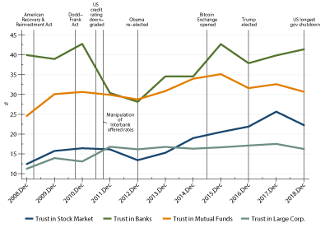
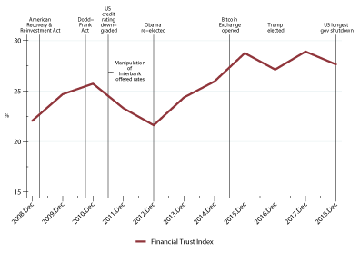
Investor Trust in Mutual Funds Increase since 2008, but is now on the decline
Results from Wave 27 of Financial Trust Index – Booth and Kellogg Schools of Business

